Slide 1
Reflections on Race, Identity & the Art of Kara Walker
Figure Study Paper Cutouts

Slide 2
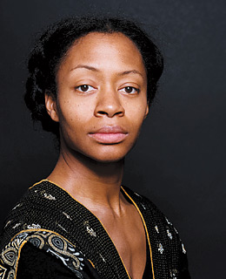
Kara Walker
Kara Walker (born November 26, 1969) is a contemporary African American artist who explores race, gender, sexuality, violence and identity in her work. She is best known for her room-size tableaux of black cut-paper silhouettes.
http://learn.walkerart.org/karawalker

Slide 3
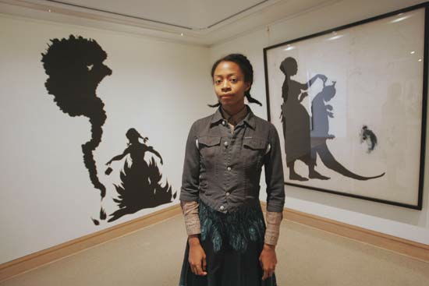
The artist and her work

Slide 4
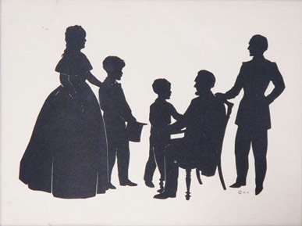
19th Century Paper-Cut Portraits

Slide 5
The Potential….

Slide 6
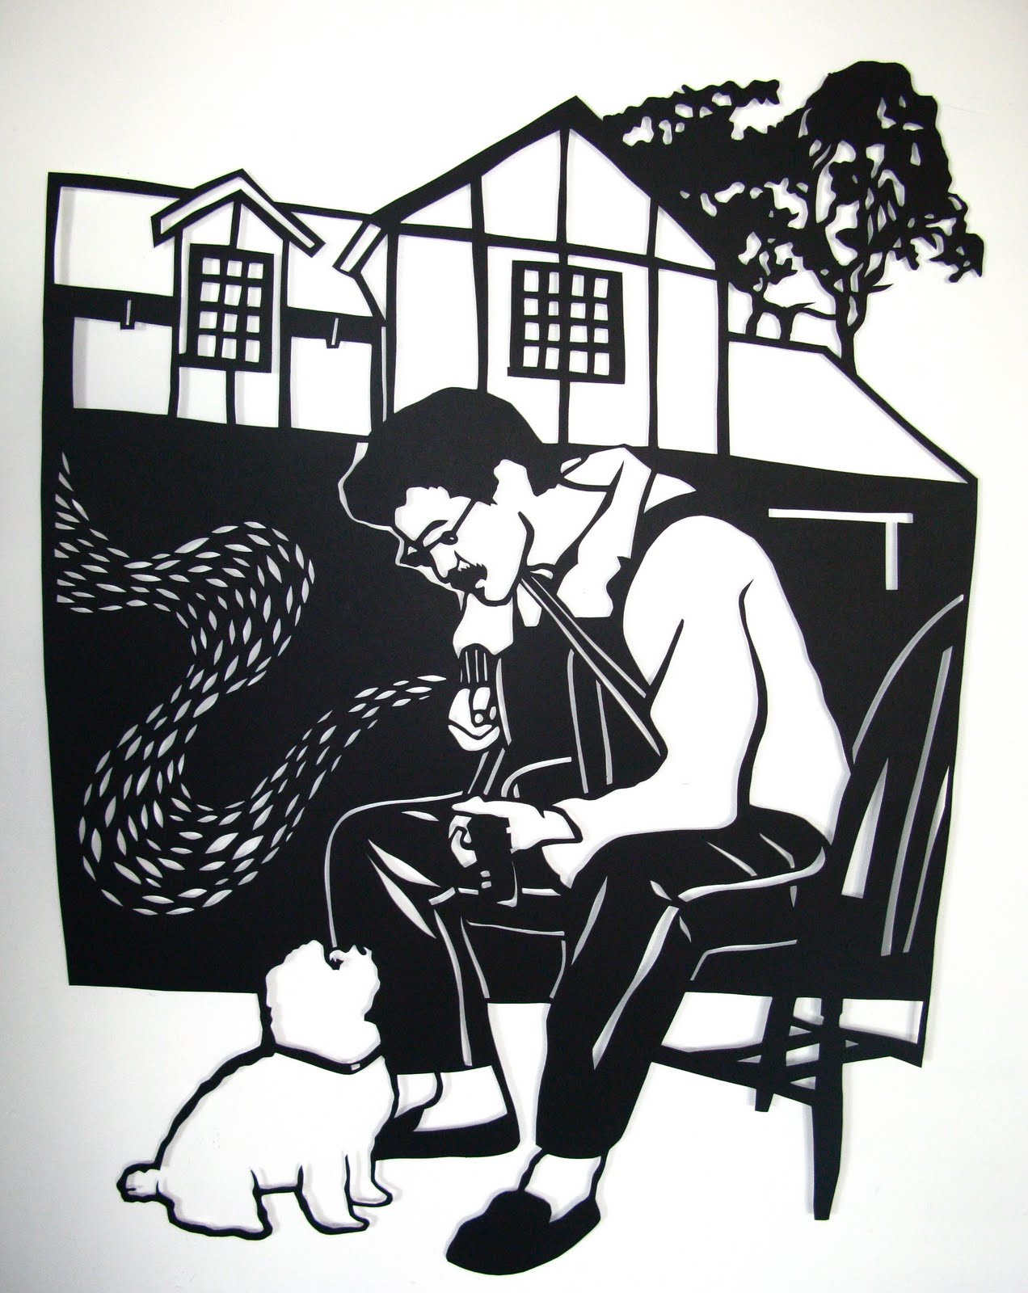
More ideas…

Slide 7
